Slide 1
Introduction
These days privacy is a very important for customers. We use IoT devices record data from variety of sensors and send it to the application server to be analyzed.
In this work, we explore a new method for anonymizing motion sensor data by tampering with the biometric content in order to avoid re-identification of persons, while still recording the activity the activity pattern.
We try to synthesize data that maintain some required statistics of the original data without information that can be used for re-identification.
We can filter the unwanted components only in time-series parts that contain sensitive information.
In addition, to improve privacy, sensitive information are removed from TF(time-frequency) representation.
We propose to use a TF encoding of signal to learn to recognize activity on one side and identity on the other.
Finally, we propose to filter sensitive identity information in this representation by canceling the highest value coefficients which correspond to the person’s activity rate.

Slide 2
Material and Method
Dataset
Dataset includes data sensed from 3-axis motion sensors at 50 Hz (constant). 3 signals are of accelerometer in 3 directions and other 3 signals are of gyrometer in 3 directions
15 trials of 24 participants performing 6 activities are recorded in this paper.
To enable activity and identity classification over time, raw motion is split in sliding windows which is a sample of a single activity.
The six activities are going downstairs, going upstairs, walking, jogging, sitting and standing.
We have used the dataset of air writing of training data size 15684 x 155 x 6 and testing data size 5850x155x6.

Slide 3
Time-frequency domain
Used to overcome the limitations of classical Fourier transform
Classical Fourier transform provides frequency content without any time information
Gives the frequency evolution of signal components as a function of time
We'll be discussing three approaches of projecting the signal in TF domain.

Slide 4
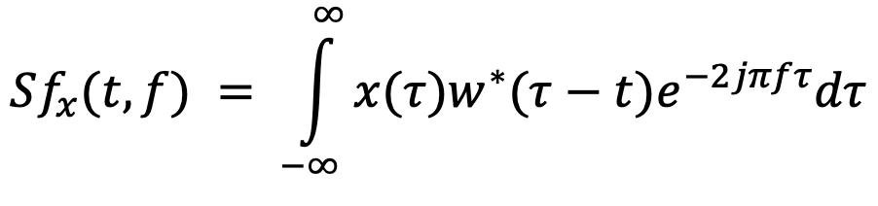
Short-Time Fourier Transform
Here, x(t) is the signal under consideration and w(t) is the analysis window which has a fixed width. The window used in the paper is a Gaussian function with σ = 0.05

Slide 5
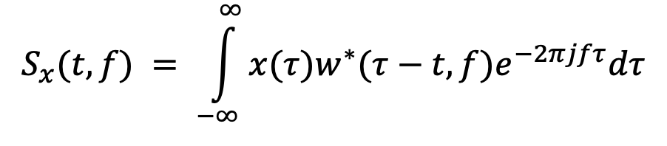
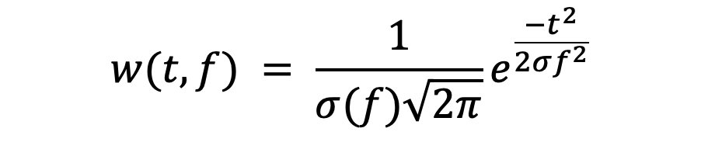
Stockwell Transform (S-transform)
Here, the analysis window w(t) is a Gaussian function of two variables, time and frequency
The standard deviation σ(f) = 1/|f|, inversely proportional to frequency to promote temporal resolution for low frequencies and frequency resolution for high frequencies.

Slide 6
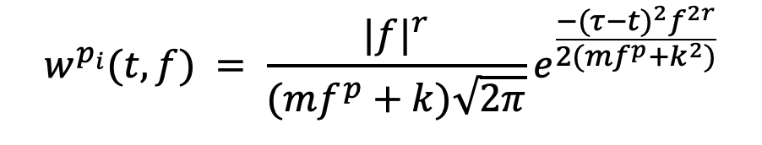
Optimized S-transform
To better adapt the analysis window to the nature of the signal being analyzed, the S-transform representation was optimized by introducing new parameters on the Gaussian window. A generalized Gaussian window controlled by a set of parameters was proposed.
Set of parameters p_{i} = {r,m,p,k} is chosen that maximizes an energy concentration function given by some concentration measurements (CM) given in the paper.
In our case, the optimal parameters calculated are fixed as follows:
r = 0.7, m = 0, p = 0 and k = 0.4

Slide 7
Identity filtering
TF images generated from the different TF transformations have a size of 62 and 128 pixels in spectral and temporal domains respectively
TF images for a particular activity present different patterns and can be demonstrated in terms of texture, like the number of vertical peaks.
When we take TF images of a particular activity( like running or jogging) of 2 users, differences can be spotted between them, like difference in contrasts of peak. These observations help in filtering high coefficients to remove user information.

Slide 8
CNN classifier
We use 2 CNNs and train them separately as classifier to measure performance of our framework.
One of the network classifies the signals into one of 4 classes(activities) and another network classifies the same signals into one of 24 classes (subjects).
Architecture: Two methods can be used build a CNN, namely "Early Fusion" strategy which gives low computational complexity and an easy implementation.
Another one is "Late Fusion" strategy which accounts for better complexity than the earlier one and it processes each input image on distinct convolutional branches and merging features at higher level.
Implementation : 90% of given signals are used as training set and remaining 10% are used for validation. Cross-entropy loss function is used as cost function and the batch size in optimization stage is set to 128.

Slide 9
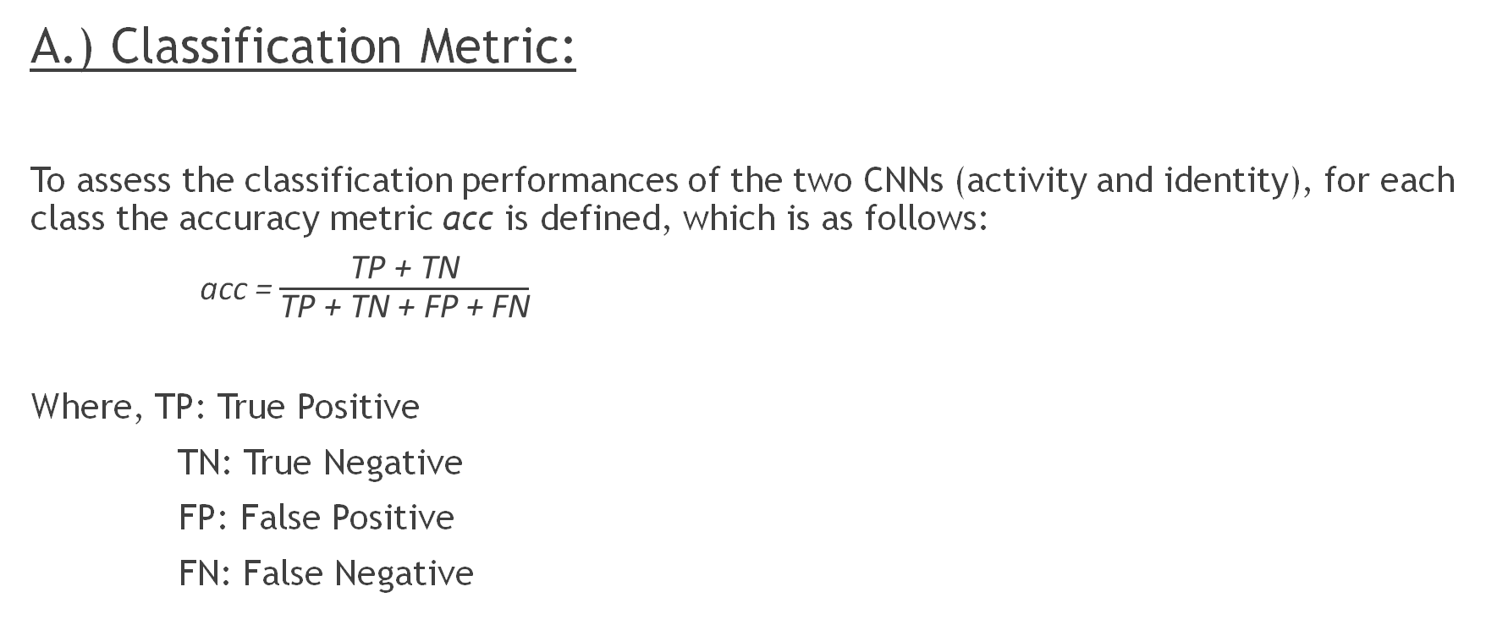
Evaluation
A.) Classification Metric:
To assess the classification performances of the two CNNs (activity and identity), for each class the accuracy metric acc is defined, which is as follows:
acc = $\frac{\text{TP}\text{ + }\text{TN}}{\text{TP}\text{ + }\text{TN}\text{ + }\text{FP}\text{ + }\text{FN}}$
Where, TP: True Positive
TN: True Negative
FP: False Positive
FN: False Negative

Slide 10
B.) State-of-the-art baseline:
To compare the performance, we need a reference.
A baseline can be created based on the Fourier Transform of the Acceleration Signal.
As we know, Fourier transform provides frequency components of the whole signal which is not sufficient to describe the signal properly.
Plots based on Fourier transform should give less accurate results than other three methods.

Slide 11
C.) Optimal representation metric:
Best TF representation would be the one that maximizes the Area Under the utility-privacy Curve (AUC) using the trapezoidal rule.
AUC: It is a method which calculates the area under graph of sub intervals and sums them up.
Here trapezoidal rule has been considered to calculate the area of each sub interval.

Slide 12
D.) Optimal filter:
An optimal filter can be used as the filter minimizing the Euclidean distance between a point from the utility-privacy curve and the upper left corner of normalized area.
This optimal filter guarantees a good activity recognition while limiting identity identification.

Slide 13
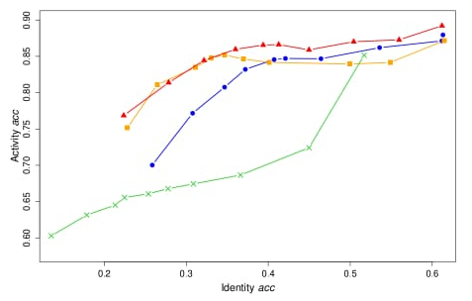
Result and Discussion
A.) Interest of Time-Frequency Representation:
Using frequency domain only leads to a significant loss of identity information as FT is unable to analyze non-stationary signals. So, TF provided better trade-off between user identification and activity recognition. Also, filtering has very low effect on activity recognition performance.
Fourier Transform
STFT
S-Transform
Optimized S-Transform

Slide 14
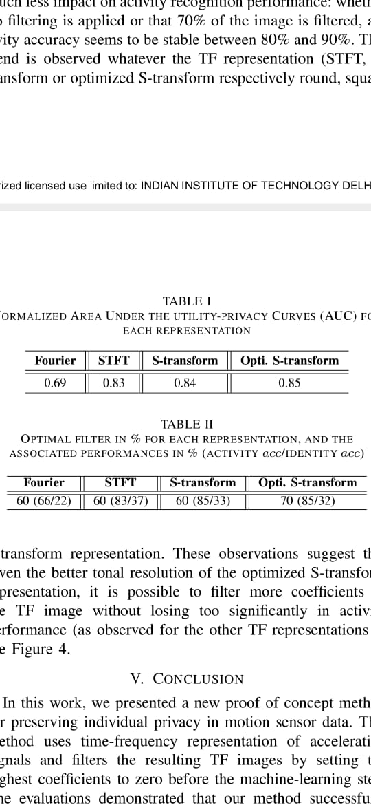
B.) Optimal Representation:
Area Under the utility-privacy Curve(AUC) tells us about the trade-off between utility and privacy. So, higher the normalized AUC better is the performance of our model in terms of utility and privacy.
The better is the energy concentration in the time-frequency plane which means a better tonal resolution of the TF image that implies faster the neural network converges.
Fig: Table showing normalized AUC for each presentation

Slide 15
C.) Optimal Filter:
For different presentations optimal filter percentage is given below-
These observations suggest that given the better tonal resolution of the optimized S-transform representation, it is possible to filter more coefficients of the TF image without losing too significantly in activity performance.

Slide 16
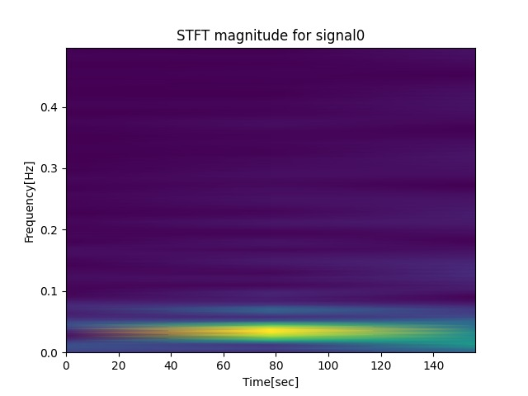
Following slides shows the Time Frequency Images obtained by using Short Time Fourier Transform

Slide 17
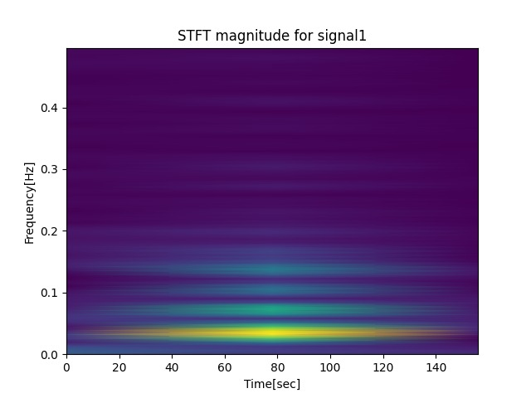

Slide 18
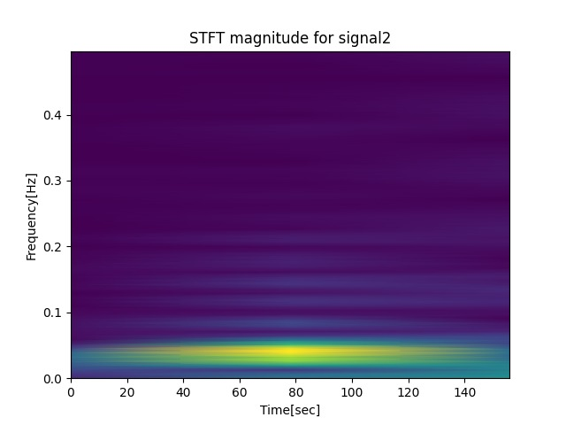

Slide 19
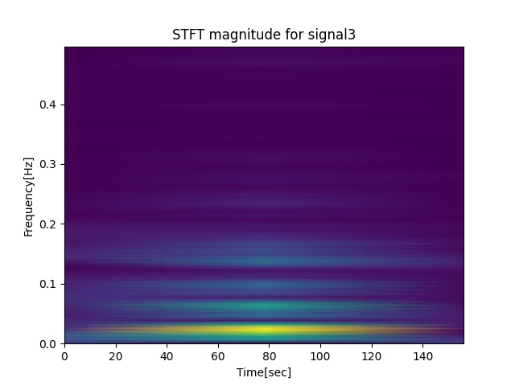

Slide 20
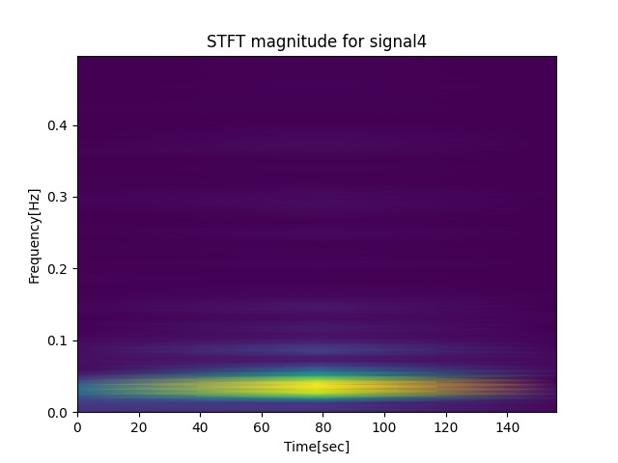

Slide 21
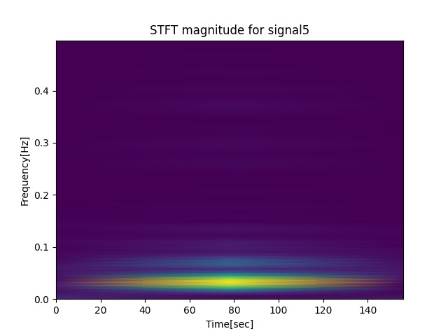

Slide 22
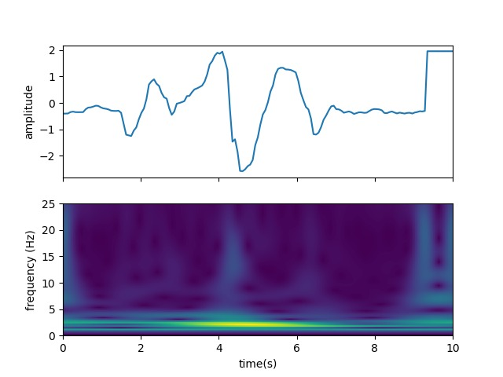
Following slides shows the Time-Frequency Image obtained
using Stockwell Transform

Slide 23
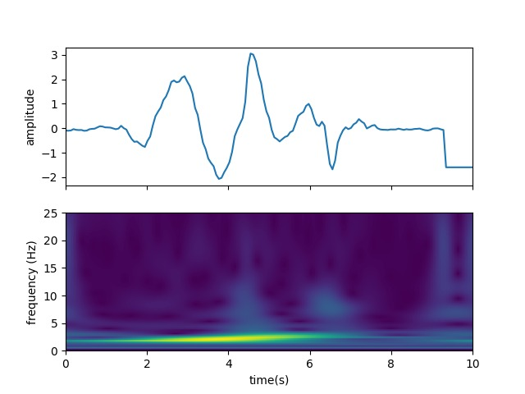

Slide 24
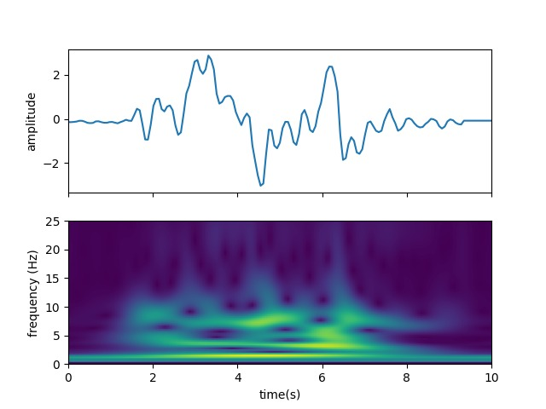

Slide 25
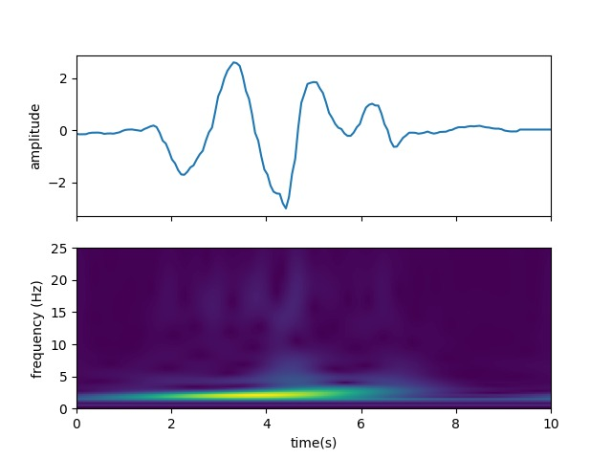

Slide 26
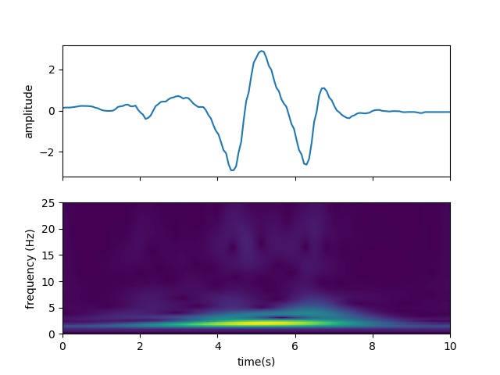

Slide 27
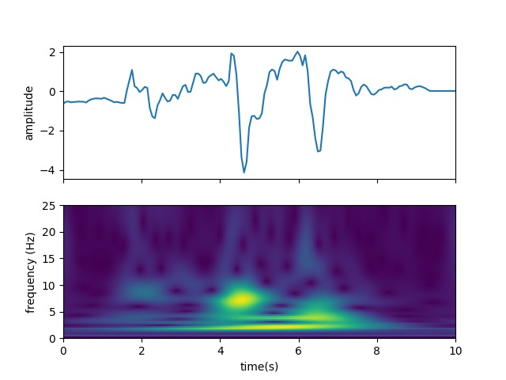

Slide 28
Results
Using STFT the size of the TF matrix obtained is 16x11 and the activity identification accuracy obtained is 57.81%
Using Stockwell Transform the size of the TF matrix obtained is 78x155 and the accuracy of the identification obtained is 66.54%.

